Slide 1
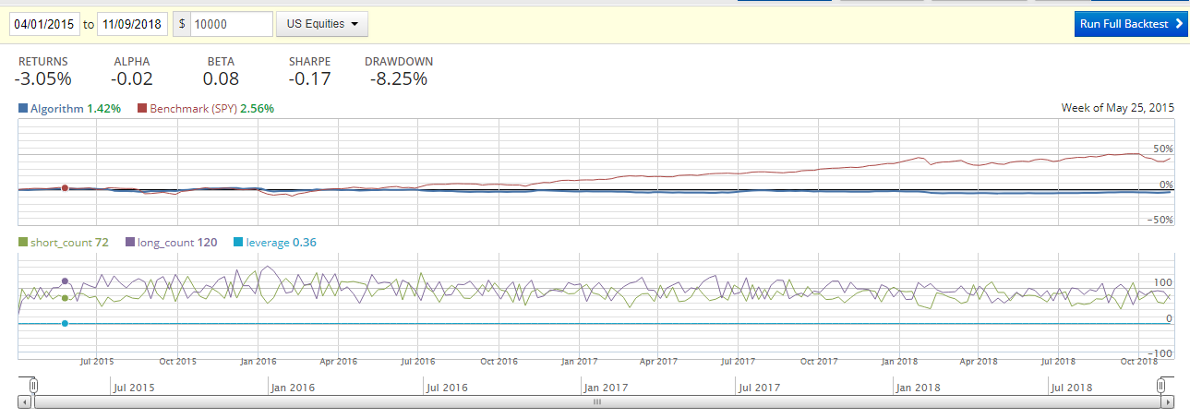
mean-reversion algorithm – back testing results
Testing Period Apr 2015 – 9 Nov 2018
Final results Algo fails to exceed return from Benchmark SPY
SPY
Algo

